Slide 1
We are a pilgrim school and we journey with Mary to become the person God intends us to be.
KS5 Independent Learning

Slide 2
We are a pilgrim school and we journey with Mary to become the person God intends us to be.
Why Complete Independent Learning?
Research by the Education Endowment Foundation (EEF) highlights that students who engage in independent study are more likely to develop a deeper understanding of their subjects and improve their overall academic performance. Moreover, it fosters essential skills such as critical thinking, self-discipline, and time management, all of which are vital for both higher education and future careers.
Here’s why you should do it:
Deepen your subject knowledge and understanding.
Strengthen research and critical thinking skills.
Build transferable skills for university and beyond.
Enhance your confidence in tackling complex problems.

Slide 3
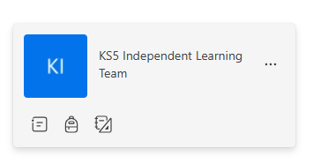
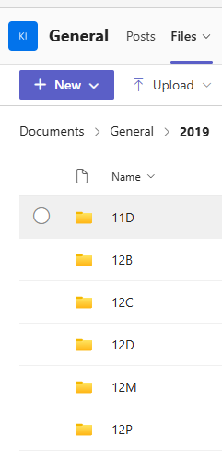
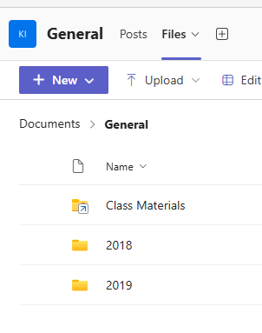
We are a pilgrim school and we journey with Mary to become the person God intends us to be.
Files > Year Group
Find your form
Microsoft Teams
Year 13
Year 12
Accessing Your Folder

Slide 4
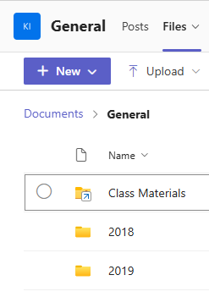
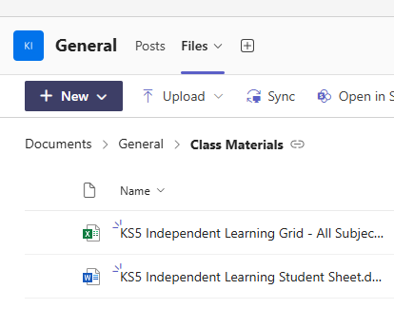
We are a pilgrim school and we journey with Mary to become the person God intends us to be.
Click on Files > Class Materials
Click on the Excel spreadsheet to access the tasks
Accessing Your Tasks
Download a copy of the Word document and save it in your own folder (right click on the dots to do this)

Slide 5
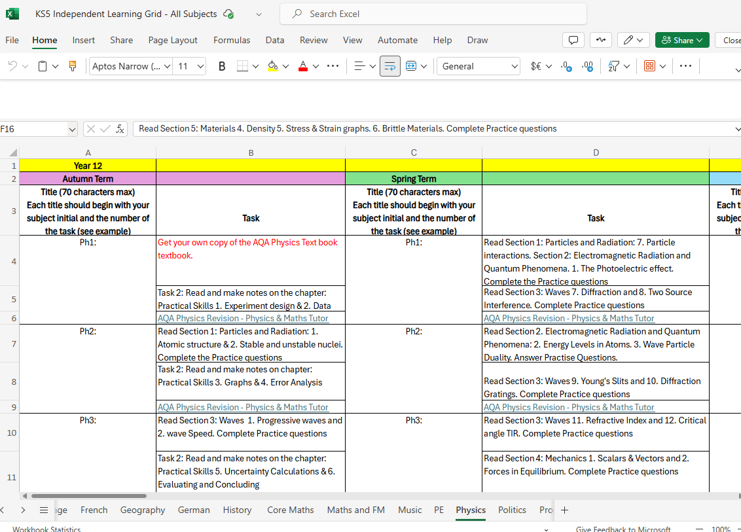
We are a pilgrim school and we journey with Mary to become the person God intends us to be.
Click on the link to access the tasks.
The tabs at the bottom are labelled with your subjects.
Look out for the relevant term and choose a task you think will be interesting and useful.

Slide 6
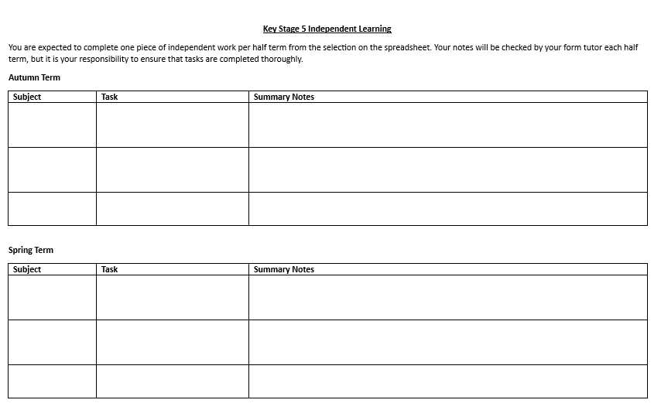
We are a pilgrim school and we journey with Mary to become the person God intends us to be.
When you have completed a task, write a summary of your learning on the Word document you have saved in your folder.
Summaries need to be around 250 words.

Slide 7
We are a pilgrim school and we journey with Mary to become the person God intends us to be.
Expectations
One independent learning task per subject completed each half term
After each task, complete your Learning Record (Word document)
Half termly check-in with form tutor to share your progress
It is YOUR responsibility to complete this work
See MRs Crawford or the Sixth Form team if you have any further questions

